Slide 1
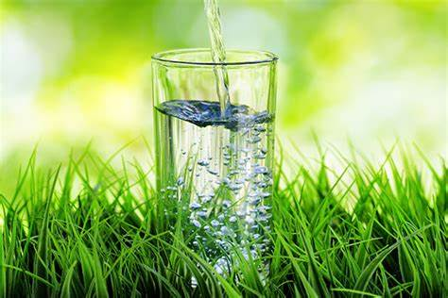
Water Quality Assessment
Problem type: Classification

Slide 2

Investments in water supply and sanitation can yield a net economic benefit, since the reductions in adverse health effects and health care costs outweigh the costs of undertaking the interventions.
Assessment of water quality requires lab experiments, chemist and substantial time
Involving such process to assess water quality for hundreds of thousands of individual region is almost impossible
Problem Statement
How to Check Water Quality fast
Decide whether water quality is acceptable.
If not acceptable, based on parameter value take action.

Slide 3
MIST’s target is to help assessing the Milk Grade of different Supplies
Identified the data required to address Target: Do Critical thinking on Target:
Target
Classify Milk Grade
Chemical Characteristics
Physical Characteristics
Region
Taste
Solid particles Turbidity
Color
Ph
Carbonate
Sulfate

Slide 4
Water Quality History Data.
Chloramines: Chlorine and chloramine are the major disinfectants used in public water systems. Upto 4mg/liter is safe
Organic_carbon: Total Organic Carbon (TOC) in source waters comes from decaying natural organic matter (NOM)
Trihalomethanes: THMs are chemicals which may be found in water treated with chlorine. 80ppm is safe.
Potability:
Indicates if water is safe for human consumption where 1 means Potable and 0 means Not potable.

Slide 5

So lets Run with a Robot AI…..

Slide 6
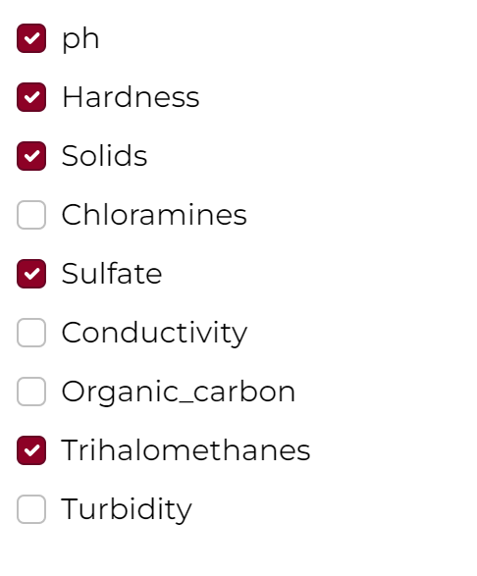
Get the Decision with 4 Steps
Login
Create a Project Environment and Solution Name “Water quality”→ solution type: Classification→ Click create solution
Data
Build Model
Upload water_quality_train.csv data
A variable list will show up→ click on skip
Select target. Choose “Grade” as your target
A window will pop up asking you run the preliminary analysis or not. Press Yes Button
Preliminary analysis will run-→see result in Confusion matrix chart and Prediction KPI for error
Press Next→ land in “build Model page
Select Variables
Uncheck variable 1,2,3
Select Algorithm
Click on Train
Click on Finalize
You will land on Deploy page
Selected Best Variable

Slide 7
Get the decision with 4 steps
Deploy
Decision
Click on Add data→
upload new data from CSV source from you computer milk_quality_pred.csv file
A variable list will show up→ click on skip
Go to Data Post Process
Create 3 equation by clicking on create custom variable
Action:
If Potability = No,
Trihalomethanes < 80mm, Work on THM
Chloramine > 4, Work on THM
Go to Result Configuration
Check download as CSV
Select Algorithm
Linear regression
XGBoost
Press “Predict”, prediction will running
Press Next→ you will land in Decision Page
Select Decision Scenario Tab
Change slider value for different variables
Press Apply
Do the step until Target or Target desired value is higher or lower or middle

Slide 8
Lets Do the same problem with regression
Login
Create Solution Name “Water quality regress”→ solution type: regression→ Click create solution
Data
Build Model
Upload water_quality_train.csv data
A variable list will show up→ click on skip
Select target. Choose “Grade” as your target
A window will pop up asking you run the preliminary analysis or not. Press Yes Button
Preliminary analysis will run-→see result in Confusion matrix chart and Prediction KPI for error
Press Next→ land in “build Model page
Select Variables
Uncheck variable 1,2,3
Select Algorithm
Click on Train
Click on Finalize
You will land on Deploy page
Selected Best Variable

Slide 9


